Slide 1
Lecture_09

Slide 2
No. 58

Slide 3

Arithmetic
Progressions
Word problems based on S_{n} formula

Slide 4
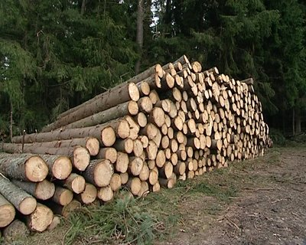


Exercise 5.3 19
19) 200 logs are stacked in the following manner, 20 logs in the bottom row,
19 in next row, 18 in the next to it and so on. In how many rows are the
200 logs placed and how many logs are in the top row?
We need to find no. of rows i.e. value of ‘n’
Sol:
Number of logs placed in successive row starting
from bottom are as follows:
20,
19,
18,
…
These numbers form an A.P.
with a = 20
and d =
19 – 20
= – 1
Total number of logs =
S_{n}
= 200
Total no. of logs = 200 i.e. S_{n} = 200
3rd row, 18 logs
2nd row, 19 logs
1st row, 20 logs

Slide 5
19) 200 logs are stacked in the following manner, 20 logs in the bottom row,
19 in next row, 18 in the next to it and so on. In how many rows are the
200 logs placed and how many logs are in the top row?
Sol:
Number of logs placed in successive row starting
from bottom are as follows:
20,
19,
For given value of S_{n},
Lets use the formula
18,
…
These numbers form an A.P.
with a = 20
and d =
19 – 20
= – 1
Substitute,
a = 20, d = -1 & S_{n} = 200
400
Total number of logs =
∴ n
(n – 25)
– 16
(n – 25)
= 0
S_{n}
= 200
∴ (n – 25)
(n – 16)
2 × 2 × 2 × 2 × 5 × 5
= 0
S_{n} =
–
16
–
n – 25 = 0
or
n – 16 = 0
25
Lets find no. of logs in 25th row
∴ n = 25
or
That means in 25th row there are -4 logs
∴ 200 =
n = 16
when, n = 25
∴ 200 × 2 =
It’s a quadratic equation, lets solve it by factorisation method
a₂₅ =
a + 24d
= 20 +
24(-1)
= 20 – 24
= – 4
∴ 400 =
Lets find no. of logs in 16th row
Since, number of logs cannot be negative
That means in 16th row there are 5 logs
∴ 400 =
∴ n ≠ 25
∴ n² – 41n + 400 =
0
when, n = 16
∴ n²
– 25n – 16n
+ 400 =
0
a₁₆ =
a + 15d
= 20 +
15(-1)
= 20 – 15
= 5
∴ Number of rows in which 200 logs placed are 16 and 5 logs are placed in top row.

Slide 6
No. 59

Slide 7
Arithmetic
Progressions
Word problems based on S_{n} formula

Slide 8



Exercise 5.3 20
Q.20] In a potato race, a bucket at the starting point, which is 5m from the
first potato and the other potatoes are placed 3m apart in a straight line. There are ten potatoes in the line.
A competitor starts from the bucket, picks up the nearest potato, runs back with it, drops it in the bucket, runs back to pick up the next potato, runs to the bucket to drop it in and she continues in the same way until all the potatoes are in the bucket. What is the total distance the competitor has to run?
Sol:
5 m
3 m
3 m
3 m
3 m

Slide 9
Q.20] In a potato race, a bucket at the starting point, which is 5m from the
first potato and the other potatoes are placed 3m apart in a straight line. There are ten potatoes in the line.
A competitor starts from the bucket, picks up the nearest potato, runs back with it, drops it in the bucket, runs back to pick up the next potato, runs to the bucket to drop it in and she continues in the same way until all the potatoes are in the bucket. What is the total distance the competitor has to run?
Sol:
The distance of potatoes are as follows:
5,
8,
11,
…
Lets make a list of distance of potatoes from bucket
Since, there are 10 potatoes that means we need to find S₁₀
These numbers form an A.P.
with a = 5
and d =
8 – 5
= 3
For S₁₀ substitute,
n = 10, a = 5 & d = 3
We know that,
As every time he has to run back to the bucket, therefore, the total distance that the competitor has to run will be two times of it.
S_{n} =
5m
3m
3m
3m
3m
∴ S₁₀ =
Distance of first potato from bucket
Distance of second potato from bucket
Distance of third potato from bucket
∴ Total distance that the competitor will run
= 2 × 185
= 370m
∴ S₁₀ = 185

Slide 10
No. 60

Slide 11
Arithmetic
Progressions
Additional sums based on concepts of AP

Slide 12
HOMEWORK
Additional example
Q.1] The 24th term of an AP is twice its 10th term. Show that its
72nd term is 4 times its 15th term.
a₂₄ = a + 23d
a₁₀ = a + 9d
Sol:
a₂₄ =
2 (a₁₀)
Lets check, what is given?
Show that
a₇₂ =
∴
a + 23d =
2
(a + 9d)
4 (a₁₅)
∴
a + 23d =
2a
+ 18d
Lets simplify LHS & RHS
∴
23d – 18d =
2a – a
∴
5d =
a
….(i)
a₇₂ = a + 71d
a₁₅ = a + 14d
LHS,
RHS,
a₇₂
= a + 71d
4(a₁₅)
= 4(a + 14d)
= 5d + 71d
= 4(5d + 14d)
= 76d
= 4(29d)
= 76d
∴
a₇₂ = 4 (a₁₅)

Slide 13
Additional example
Q.2] The sum of first n terms of an AP is 5n² + 3n. If its mth term is 168, find the value of m. Also, find the 20th term of this AP.
Sol:
S_{n} =
5n² + 3n
d =
a₂ – a₁
Find S₁ by putting n = 1
Find S₂ by putting n = 2
∴ S₁ =
5(1)²
+ 3(1)
= 18 – 8
– S₁
S₁ means sum of first term i.e. first term itself
= 5
+ 3
= 10
= 8
a_{m}
= 168
∴ S₁ =
a₁ =
8
∴ a + (m – 1)d
= 168
a_{m} = a + (m – 1)d
5(2)²
+ 3(2)
∴ 8
+ (m – 1)
10
= 168
∴ S₂ =
∴ (m – 1)10
= 160
+ 6
= 5(4)
∴ m – 1
= 16
= 20
+ 6
∴ m
= 17
= 26
a₂₀
= a + 19d
a₂ = S₂ – S₁
= 8
+ 19(10)
= 26 – 8
= 8 + 190
= 18
a₂₀
= 198

Slide 14
No. 61

Slide 15
Arithmetic
Progressions
Additional sums based on concepts of AP

Slide 16
Additional example
Q.3] The sum of first m terms of an AP is same as the sum of its n terms, show that the sum of its (m + n) term is zero. (m - n ≠ 0)
Sol:
S_{m}
=
S_{n}
For S_{m},
replace n by m
We need to show that:
S_{(m + n)} = 0
S_{(m + n)}
=
By using
a² – b² = (a – b)(a + b)
Bring all terms to LHS
We need ‘0’ in RHS
m
[2a
+ md
– d ]
=
n
[2a
+ nd
– d ]
Take 2a common
Take d common
Take -d common
2am
+ m²d
– md
=
2an
+ n²d
– nd
How to get (m – n) in this term?
S_{(m+n)}
2am
– 2an
+ m²d
– n²d
– md
+ nd
= 0
Take (m – n) common
[2a + dm + dn – d]
2a
(m – n)
+ d
(m² – n²)
– d
(m – n)
= 0
2a(m – n)
+ d
(m + n)(m – n)
– d(m – n)
= 0
[0]
…(From i)
(m – n)
[2a
+ d(m + n)
– d]
= 0
S_{(m+n)} = 0
2a + d(m + n) – d
= 0
The sum of (m + n)^{th} term is 0
2a + dm + dn – d
= 0
….(i)

Slide 17
No. 62

Slide 18
Arithmetic
Progressions
Additional sums based on concepts of AP

Slide 19
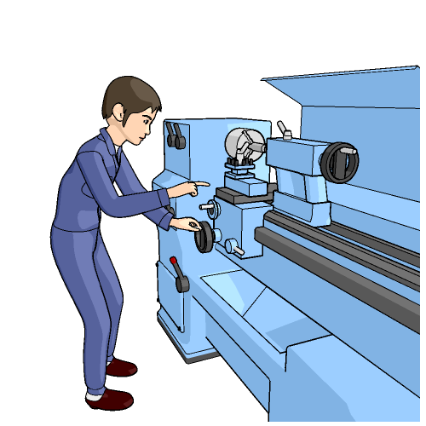
Additional example
Q.4] A piece of equipment cost a certain factory Rs.6,00,000.
If it depreciates in value, 15% the first year, 13.5% the next year, 12% the third year, and so on. What will be its value at the end of 10 years, all percentage applying to the original cost?
Decrease in value
For example:
If total depreciation value of the same equipment in 10 years is Rs.4,00,000
We need to find:
Total depreciation value of equipment in 10 years
Sol:
The amount of depreciation for successive
years are:
Cost Rs.6,00,000
90000,
81000,
72000,
…
End of first year
– 15%
Find S₁₀ for list of depreciation value
These amount forms an AP
of Rs.6,00,000
Then value of equipment at the end of 10 years will be
6,00,000 – 4,00,000
= Rs.2,00,000
Lets make list of depreciation value for successive years
End of second year
– 13.5%
of Rs.6,00,000
End of third year
– 12%
of Rs.6,00,000

Slide 20
Q.4] A piece of equipment cost a certain factory Rs.6,00,000.
If it depreciates in value, 15% the first, 13.5% the next year, 12% the third year, and so on. What will be its value at the end of 10 years, all percentage applying to the original cost?
We need to find:
Total depreciation value of equipment in 10 years
Sol:
The amount of depreciation for successive
years are:
90000,
81000,
72000,
…
Which forms an A.P.
with a = 90000
Find S₁₀ for list of depreciation value
and d =
81000 – 90000
= – 9000
We know that,
In 10 years value of equipment
depreciates by Rs.4,95,000
S_{n} =
Value of equipment at the end of
10 years will be
∴ S₁₀ =
= 600000 – 495000
= Rs.105000
= 5
[ 180000
+ 9 (– 9000) ]
= 5
[ 180000
– 81000 ]
= 5
[ 99000 ]
= 495000

Slide 21
Thank You

